Slide 1

Data Science Summit 2016
San Francisco

Slide 2
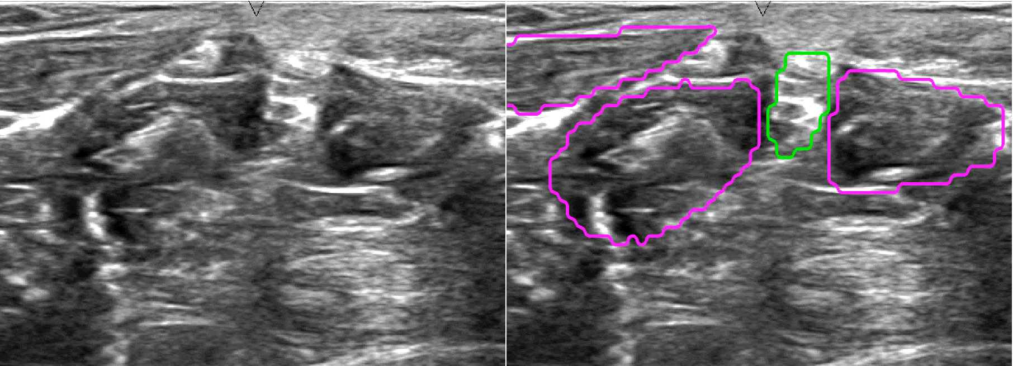
Why do we care about AI?
PACMAN: Nerve Visualization

Slide 3
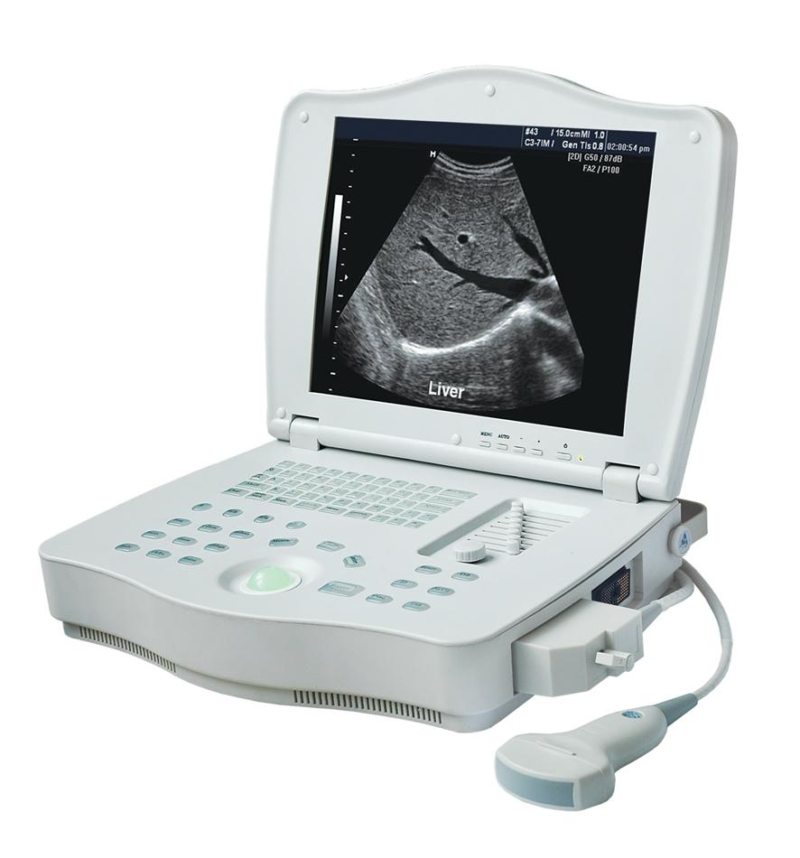

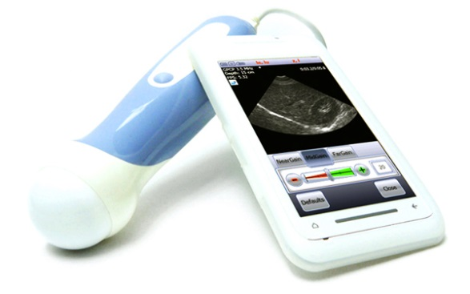
Vision

Slide 4
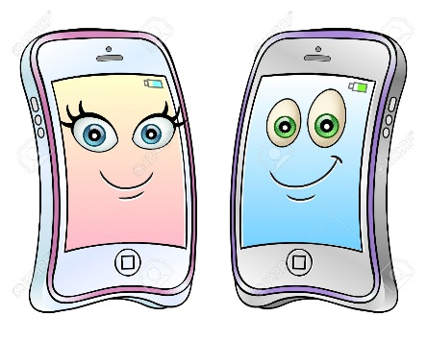
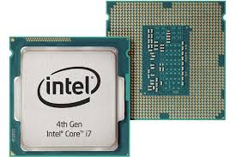
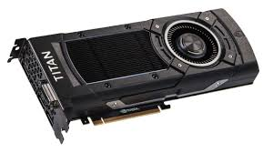
Challenges
PACMAN goals
High performance: accuracy
Low computational time

Slide 5
AI Pipeline
AI Pipeline
Data Collection
Data cleaning & Preparation
Data Annotations
AI Training
AI Deploy
Prediction

Slide 6
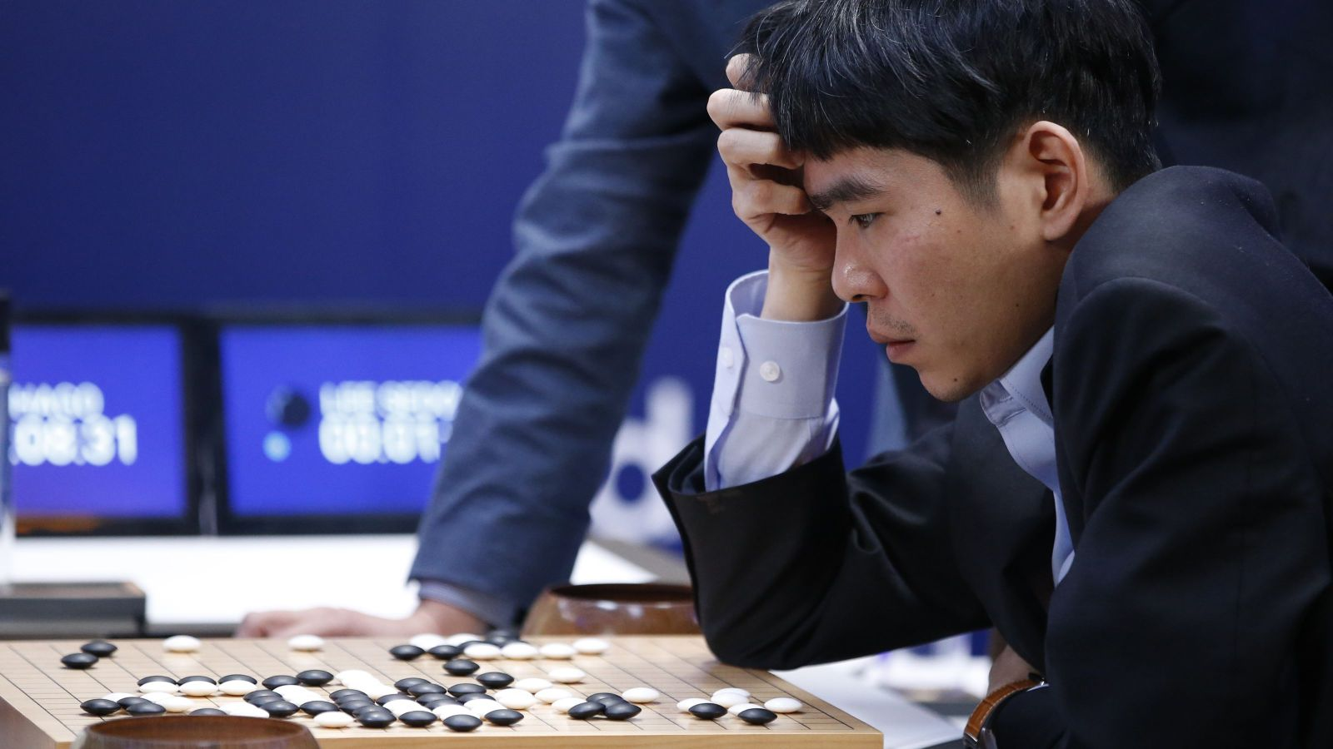
What is new in AI?
Google AlphaGo AI beats GO champion
Using AI to save energy

Slide 7
Overall
Two-day conference
Speakers
50 speakers for data science summit
20 speakers for startup session
State of the art in data science and AI
Some good ideas for our work

Slide 8




Companies
Pinterest
Pandora: Music Recommendation
Concur
Microsoft
…

Slide 9




AI Transparency
Keynote: Carlos Guestrin, Associate Professor, University of Washington
Why Should I Trust You?
Transparency
Trusting a prediction
Trusting a model

Slide 10
AI Transparency

Slide 11
Transparency Example

Slide 12
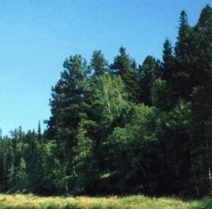
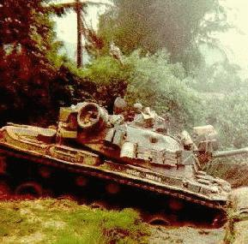
Lazy AI!
Using of the color of the sky

Slide 13
Human vs. Machine
Do Humans and AI Look at the Same Regions?

Slide 14
Human Attention
Question: How many players are visible in the image?

Slide 15
Human vs Machine
What are they doing?
Current AI models do not seem to be looking at the same regions as humans.

Slide 16
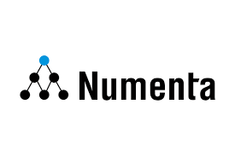
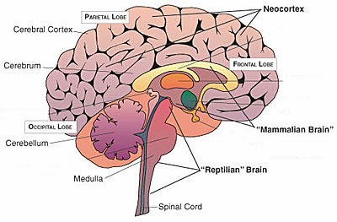
Talks
Numenta
The path to machine intelligence
Neocortex
Unsupervised
Unlabeled data

Slide 17

AI Paradigms
Supervised | Unsupervised
Require lots of examples with labels Most of current AI | Less examples, no/less labels Future AI

Slide 18


Talks
Kaggle: Data science competitions
Anthony Goldbloom, co-founder: Kaggle
Dominating methods
New Features

Slide 19
Real-Time Object Detection

Slide 20
Real time Demo
http://pjreddie.com/darknet/yolo/
30 frames/sec

Slide 21
Image Classification Using Binary Weights
3.04342423*2.0242352423

Slide 22
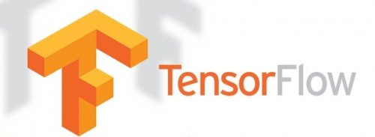
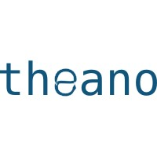



Other Talks
Jeff Dean, Google
Tensorflow, Deep Learning Library

Slide 23

Startups
Domino data lab
Github for data science
More iterations. Better collaboration. Greater return on data.

Slide 24

Startups
Crowdflower
Machine Learning Data Pipeline
Data collection
Annotation
Cleaning

Slide 25
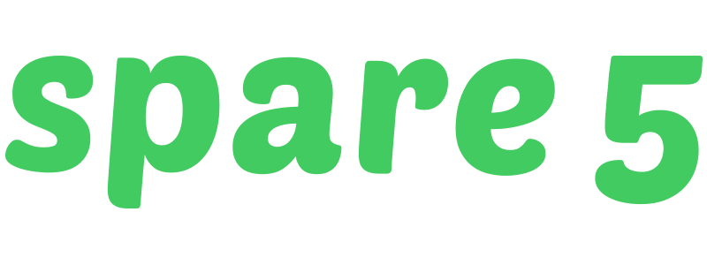
Startups
Spare 5
Training data for machine learning
Clean labeled data at scale
Datasets to train and test machine learning models.

Slide 26
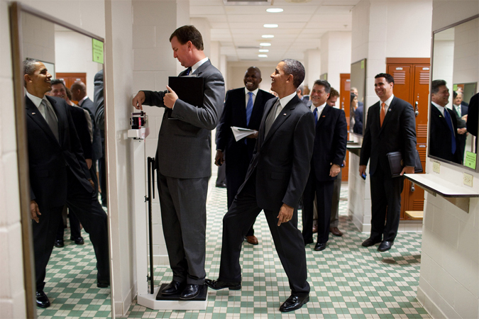
Looking Ahead
We have way to go

Slide 27
Looking Ahead
“What if a cure for an intractable cancer is hidden within the tedious reports on thousands of clinical studies? In 20 years’ time, AI will be able to read — and more importantly, understand — scientific text. These AI readers will be able to connect the dots between disparate studies to identify novel hypotheses and to suggest experiments which would otherwise be missed. AI-based discovery engines will help find the answers to science's thorniest problems.”
Oren Etzioni, professor of Computer Science and CEO of the Allen Institute for Artificial Intelligence

Slide 28
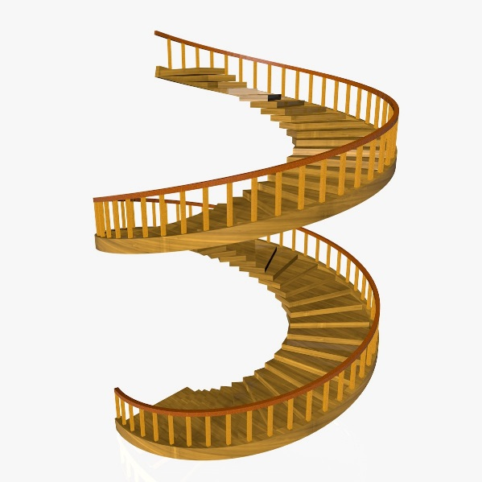
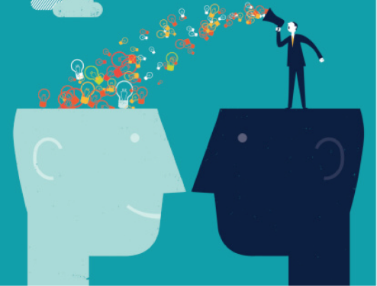


Takeaways ☺
Crowded: 1300 attendees
Lectures location: quite workout
Lots of speakers
Progress in AI field
A few good ideas for PACMAN

